Slide 1
Memory Coherence in Shared Virtual Memory Systems
Geng Hexiang, Li Minghang

Slide 2
Outline
1) Introduction
2) Centralized Manager Algorithms
3) Distributed Manager Algorithms
4) Experiments
5) Conclusion

Slide 3
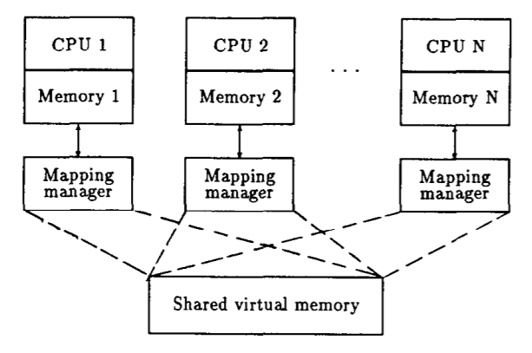
Intro: Shared Virtual Memory
Shared Virtual Memory:
  A shared virtual address space among all processors in a loosely coupled distributed-memory multiprocessor system.
  Act just like the traditional virtual memory for non-parallel applications.
  Allow application to run on different processors in parallel.
  “Pages” data between physical memory and disks, and between physical memories of different processors
Notes:
First, let’s define a shared virtual memory.
A shared virtual memory is a shared virtual address space among all processors in a loosly coupled distributed-memory multiprocessor system.
For non-parallel applications, it behaves just the same as the traditional virtual memory
But it allows application to run on different processors in parallel.
It not only pages data between physical memory and disks like a traditional one, it also pages across physical memories of different processors.

Slide 4
Intro: Shared Virtual Memory
Memory Coherence:
  The value returned by a read operation is always the same as the value written by the most recent write operation to the same address
Strategies:
Page Synchronization:
  Invalidation
  Write-broadcast
Page Ownership:
  Fixed
  Dynamic
Notes:
In the design of a shared virtual memory, one problem is very important. It is memory coherence.
The definition of memory coherence is that, the value returned by a read operation is always the same as the value written by the most recent write operation to the same address.
There are several strategies to maintain memory coherence, but we can classify them by two aspects. One is the way of page synchronization, there are invalidation method and write-broadcast method. And the page ownership, whether it’s fixed or dynamic.

Slide 5
Invalidation: write fault
1. Invalidates all copies
2. Requester changes access
to write
3. Moves a copy if not already
have one
Page
4. Returns to the faulting
instruction
Request
Write fault happens
Processor with write access to page
Processor with read-only access to page
Processor with no valid local copy to page
Notes:
Let’s talk about invalidation method for page synchronization first.
Here is an example of a write fault.
The blue rings represent the processors with no valid local copy of a page.
The green ones represent the processors with read-only access
and the red one for the “owner”, with write access.
In the situation of a write fault, after the owner receives the request, it first invalidates all copies.
Then the requester changes its access to write, becoming the new owner of the page.
Of course, if it does not have a page copy, it will be sent.
Finally it returns to the faulting instruction.

Slide 6
Write-broadcasting: write fault
1. Writes to all copies
2. Returns to the faulting
instruction
Write fault happens
Processor with write access to page
Processor with read-only access to page
Processor with no valid local copy to page
Notes:
Let’s move on to the write-broadcasting method. You can see that we have multiple red rings, because all processors with a local copy can write to it.
Let’s skip how the copy is sent to a processor. Just when a processor needs to write, it will send messages to all copy owners, and writes to all copies.

Slide 7
Intro: Shared Virtual Memory
Invalidation page synchronization
  Invalidates all other copies when write fault
  Only one owner process
Write-broadcast page synchronization
  Write to all copies
  Requires specific hardware
  Does not seem practical
Notes:
In invalidation page synchronization, when a write fault happens, all other copies are invalidated. And there can only be one owner processor of a page.
In write-broadcast page synchronization, a write operation will write to all copies. So a write operation will always trigger a write fault.
After the fault handler returns to the faulting instruction, we have to skip it to prevent dead loop of faulting.
This will require specific hardware. At the time this paper is written, which is 1989, there was no such hardware so it did not seem practical. We are not sure whether modern devices are able to do so. So discussions are welcomed in the QnA session.

Slide 8
Introduction
Fixed page ownership
  A page is always owned by the same processor
  Other processors never have full write access
Dynamic page ownership
  Page ownership can be shifted among processors
  Two strategies
    Centralized
    Distributed
Notes:
The page ownership part is rather simple.
A fixed page ownership means a page is always owned by the same processor, and no other processors will every have full write access.
A dynamic page ownership means that the page ownership can be shifted among processors.
There are two strategies to design a dynamic page ownership. One is centralized and the other is distributed.

Slide 9
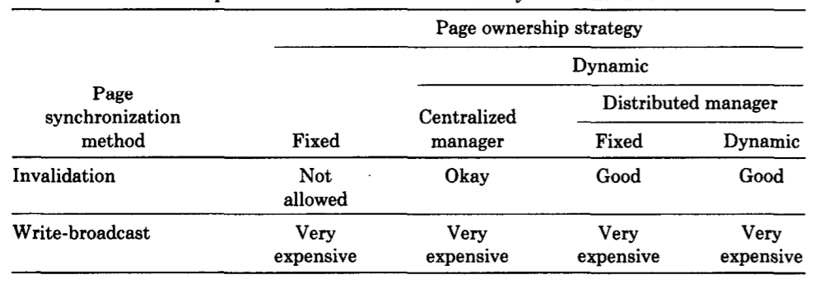
Introduction
Notes:
Here is a chart we stole from the paper. We can see that only three combinations are beyond “okay”.
And they are what we are going to discuss in detail.
The centralized manager, fix distributed manager and dynamic distributed manager. All of them use invalidation method.

Slide 10
Introduction
The process of solving memory coherence problem can be generalized into:
  Page fault happens -> Find the owner of the page -> Request the page from the owner in a synchronized way -> Invalidate/Write broadcast in a synchronized way -> Return to the faulted instruction
Basic info needed to be documented for each page:
  Access: read or write
  Copy set: the processor numbers that have read copies of the page (bit vector)
  Lock: for synchronization
Notes:
There is some information that every design approach has to find some way to store. They may have different data structures, but these are needed.
The Access, marks whether a processor can write to its local copy of page.
The copy set, marks the processors that have read-only copies, for sending invalidation messages to.
And Lock, for synchronizing concurrent requests.

Slide 11
Centralized Manager Algorithms
1) A monitor-like centralized manager algorithm
2) An improved centralized manager algorithm
Notes:
First, we are going to introduce the centralized manager algorithms, which is the most straightforward. The basic idea is that there is a central manager that handles the request and find the owner of a page. We’ll first detail about the most naïve implementation, and then introduce one improvement to it.

Slide 12
Monitor-like Centralized Manager Algorithm: Basic Data Structure
Later on, we are going to make the information stored in Info be as distributed as possible
Info
PTable
Only owned by Manager
Owned by every processor
Field | Content
Owner | States the owner ship of the page (the most recent processor with write access)
Copy set | Processors with copies of the page
Lock | For synchronization
Info | Content
Access | States the accessibility of pages locally
Lock | For synchronization
Notes:
To make the manager able to do the page management job, the manager processor will maintain a table called Info, which has one entry for each page and each entry has 3 fields: the owner field, the copy set filed and the lock field.
The owner field contains the single processor that owns that page, namely, the most recent processor that has write access to it.
The copy set field lists all processors that have copies of the page, which will allow later invalidation process.
The lock field is for synchronization.
We can see that the information is highly centralized on info table and thus it must be very busy. In later implementations, we’ll try to distribute those pieces of info to local processors
Each processor also has a page table called Ptable that has 2 fields, access and lock. This table keeps information about the accessibility of pages on the local processor.

Slide 13
Monitor-like Centralized Manager Algorithm: Basic Data Structure
Manager’s Job
  Locate the owner and forward the request
  Possible invalidation for the RequestNode
Normal processor’s Job
  Send request to manager
  Manager its own PTable
Synchronization
Both Info table and Ptable have page-based locks.
  when there’s more than 1 process on a processor waiting for the same page, it won’t send more than 1 request;
  if a remote request for a page arrives but the page table entry is being used, the request will be queued.
  Confirmation message
Notes:
In this implementation, only the manager knows who is the owner, so it will do the request and possible invalidation for the RequestNode. And since we need to do the local and server operations in a synchronized way, both Info table and Ptable have page-based locks. That is, every time we want to access either an entry in Info table or in Ptable, the corresponding Lock bit should be set. So, when there’s more than 1 process on a processor waiting for the same page, it won’t send more than 1 request; and if a remote request for a page arrives but the page table entry is being used, the request will be queued.
Furthermore, a confirmation message needs to be sent by the RequestNode to release the lock.

Slide 14

Monitor-like Centralized Algorithm: Read Fault
1. RequestNode asks the Manager for the page copy and access
2. Manager adds RequestNode to the copy set of the owner
M
3. Manager asks Owner to send a copy of the page to RequstNode
Page copy
4. Owner send the page copy
5. RequestNode sends confirmation message to Manager
Read fault happens
M
Centralized manager
Processor with write access to page
Processor with read-only access to page
A total of 4 messages for NormalNode, 2 for Manager
Processor with no valid local copy to page
Notes:
Let’s look at the implementation under two scenarios, when read fault happens and when write fault happens. So we have this processor network, with the huge black solid circle with an M in the middle as the centralized manager. When a read fault happens,
(Read 1.) It will lock its Ptable since the access need to be managed later
(Read 2,) Lock Info[p], since it is editing the copy set.
(Read 3.)
Lock OwnerNode Ptable[p], (Read 4) unlock ownernode Ptable[p]
(Read 5) Unlock RN Ptable[p], unlock Info[p]
The page-based locking mechanism is similar in the write fault scenario, so we’ll omit the details later on.
We can count that a total of 4 messages for NormalNode. If the fault happens in the Manager Node, of course it does not have to send a request and confirmaition to itself, thus saving 2 messages.

Slide 15
Monitor-like Centralized Algorithm: Write Fault
1. RequestNode asks the Manager for the page and access
2. Manager invalidates every node in the copy set of Owner and empty the copy set
M
Page
3. Manager asks Owner to send the page to RequstNode
4. Owner send the page and relinquish the ownership to RequestNode
5. RequestNode sends confirmation message to Manager
Write fault happens
M
Centralized manager
Processor with write access to page
A total of 4 messages for NormalNode, 2 for Manager + Invalidation cost
Processor with read-only access to page
Processor with no valid local copy to page
Notes:
Read ppt.

Slide 16
Monitor-like Centralized Algorithm: conclusion
Pros
  The worst-case number of messages to locate a page in the centralized algorithm is only 2
Cons
  Requires a confirmation message whenever a fault appears on a nonmanager processor
  Trafficking bottleneck on system with lots of processors
  We want to improve!
Notes:
So, what are the pros and cons of this naïve implementation? The pro is that even in the worst-case the number of msgs to find the owner of a page is just 2, best case, of course, 0. It’s because the manager has the ownership info. Later in distributed system, finding the ownership will be a problem.
And the cons are quite obvious, it requires a confirmation message to be sent every time a fault happens. When there area lot of faults, it will be quite costly. The burden of the manager will also be quite heavy if there are lots of processors thus lots of faults, causing a traffic bottleneck which will queue lots of processors and lag the program.
So we definitely want to improve this algorithm. The traffic bottleneck issue cannot be solved in a centralized system, but we can eliminate the confirmation message.

Slide 17
Improved Centralized Monitor-like System: changes in DATA STRUCT
One step further into decentralization
  Move task of the synchronization of ownership to local processor to eliminate confirmation
Info
Owner
Copy set
Lock
Owner
Owner
PTable
Access
Lock
PTable
Access
Lock
Copy set
Notes:
To eliminate confirmation, we move the task of the synchronization of ownership to local processor. Then the manager no loger needs to maintain the copy set information, thus it does not need a page-based lock. The information about the ownership of each page is still only known to the manager and Stored in a table called Owner. The entry in the Ptable now has 3 fields: access, lock and copy set.

Slide 18
Monitor-like Centralized Algorithm: Read Fault
1. RequestNode asks the Manager for the page copy and access
2. Manager forwards the request to Owner
M
3. Owner adds RequestNode to the copy set of itself
Page copy
4. Owner send the page copy
Read fault happens
M
Centralized manager
Processor with write access to page
Processor with read-only access to page
Processor with no valid local copy to page
Notes:
Let’s look at this improved algorithm briefly, still under read fault and write fault scenario.
(Read 1)
(Read 2), not that it will not handle the copy set at all
(Read 3)
(Read 4)
The page-based lock now only works on the PTable

Slide 19
Monitor-like Centralized Algorithm: Write Fault
1. RequestNode asks the Manager for the page and its copy set
2. Manager forwards the request to Owner, and edit the Owner table
M
Page and copy set
3. Owner send the page and copy set and relinquish the ownership to RequestNode
4. RequestNode invalidates every node in the copy set of Owner and empty the copy set
Write fault happens
M
Centralized manager
Processor with write access to page
Processor with read-only access to page
Processor with no valid local copy to page
Notes:
(Read ppt)
Note that in both scenarios of the improved centralized algorithm, one message cost is saved.

Slide 20
Distributed Manager Algorithms
1) A Fixed Distributed Manager Algorithm
2) A Broadcast Distributed Manager Algorithm
3) A Dynamic Distributed Manager Algorithm
4) An Improvement by Using Fewer Broadcasts
5) Distribution of Copy Sets
Notes:
Now let’s move on to the distributed manager algorithms.
Compared to centralized algorithms, the main difficulty of the distributed methods is to locate the true owner of a page in the network and be efficient in the same time.
To accomplish this, there are 5 design choices or improvements we are going to cover.

Slide 21
A Fixed Distributed Manager Algorithm
Each processor manages a predetermined subset of pages
Performance:
  Superior to the centralized manager algorithms when a parallel program exhibits a high rate of page fault.
Difficulty:
  Difficult to find a good fixed distribution function that fits all application.
Notes:
The first one we are going to talk about is the fixed distributed manager algorithm.
As its name suggests, each processor manages a predetermined subset of pages, and the ownership of each page is fixed.
This approach gives superior performance compared to centralized manager algorithm, if a high rate of page fault is appearing.
The difficulty of this method is to find a good hashing function matching the page and its manager/owner.

Slide 22
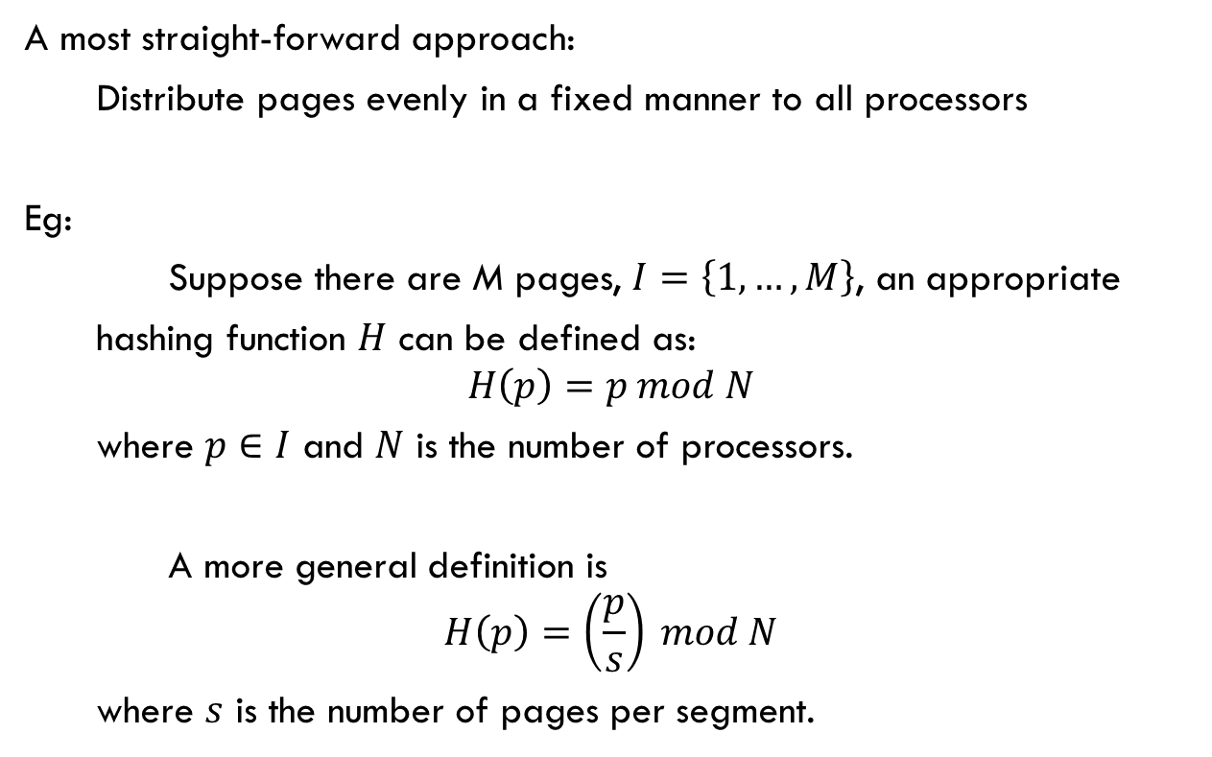
A Fixed Distributed Manager Algorithm
A most straight-forward approach:
Distribute pages evenly in a fixed manner to all processors
Eg:
Suppose there are M pages, $I=\left\{1, …, M\right\}$, an appropriate
hashing function $H$ can be defined as:
$$H\left(p\right)=p mod N$$
where $p∈I$ and $N$ is the number of processors.
A more general definition is
$$H\left(p\right)=\left(\frac{p}{s}\right) mod N$$
where $s$ is the number of pages per segment.
Notes:
Here is a most straight-forward approach, as we try to distribute pages evenly in a fixed manner to all processors.
Let’s suppose there are M pages, and N processors. The hashing function H of p is “p mod N”. Or more generally, H of p is “p over s mod N”, where s is the number of pages per segment.
However, as we talked about, a good distributing function is where the difficulty lies.

Slide 23
A Broadcast Distributed Manager Algorithm
Each processor manages precisely each page’s ownership
No Owner table needed, ownership stored in all PTables.
  PTable has an addition field owner
Uses atomic broadcast operations
  Broadcast read request
  Broadcast write request
Notes:
Next, we have a broadcast distributed manager algorithm.
In this method, each processor manages precisely each page’s ownership, meaning that each processor knows the owner of all pages at any time.
This is achieved by broadcasting all requests information to all processors.
In this design, we don’t need the Owner table, as all processors are equal, and the ownership information is in all PTables.
PTable has an addition field called owner.
Mainly we have two atomic broadcast operations. Broadcast read request and broadcast write request.

Slide 24
A Broadcast Distributed Manager Algorithm: read fault
1. Broadcast read request
2. True owner add requester
to copy set field
3. Page copy sent to requester
Page
Read fault happens
Processor with write access to page
Processor with read-only access to page
Processor with no valid local copy to page
Notes:
Let’s look at the situation of read fault.
The requester processor first broadcast a read request to all other processors.
The true owner will add the requester to the copy set field and a copy is sent to the requester

Slide 25
A Broadcast Distributed Manager Algorithm: write fault
1. Broadcast write request
2. Owner gives up ownership,
page copy and copy set sent
to requester
3. Other copies invalidated
Page
Write fault happens
Processor with write access to page
Processor with read-only access to page
Processor with no valid local copy to page
Notes:
Now let’s look at the write fault.

Slide 26

A Broadcast Distributed Manager Algorithm
Simple approach and implementation.
Correctness can be proved.
Poor performance due to broadcast requests.
  Experiments show that the broadcast request cost is substantial when $N≥4$
Notes:
All in all, the broadcast distributed manager algorithm is a simple design choice, and the implementation is rather easy.
The correctness can also be proved. In case of concurrent request, the new owner can queue up the requests so no hazard will happen.
However, because we have to broadcast a lot of requests, the performance is not as optimal.
Experiments show that the broadcast cost is substantial when the total number of processors is greater than or equal to 4.

Slide 27
A Dynamic Distributed Manager Algorithm
Compared to broadcast distributed manager algorithm, owner field in PTable is replaced by probOwner.
  Value of probOwner is “probably” owner, just a hint for searching the true owner
  The request is sent/forwarded to the processor’s probOwner if itself is not the true owner.
  True owner handles requests as in centralized manager algorithm.
  Invalidation requests, a processor relinquishing ownership and forwarding requests update probOwner.
    In first two cases, the new probOwner is the new owner of the page.
    In the last case, the new probOwner is the original requesting processor
Notes:
Next, there is a dynamic distributed manager algorithm.
Compared to the broadcast method, the “owner” field in PTable is replaced by probOwner. It suggests a “probable” owner, for searching the true owner. Each processor maintain its own probOwner field.
When a processor receives a request, and it’s not the owner, it will forward the request to its probOwner, until the request finally reaches the true owner.
The true owner will handle the request just as in the centralized manager algorithm.
When there is a change of ownership, invalidation request or a request forwarding, the processor’s probOwner is changed. In the first two cases, the new probOwner is the new owner, and in the last case, the new probOwner is the original requesting processor.

Slide 28
A Dynamic Distributed Manager Algorithm: read fault
1. Send read fault request
2. Forward request and
probOwner changed
3. Page copy sent to requester
probOwner changed
Page
Read fault happens
Points to a processor’s probOwner
Processor with write access to page
Processor with read-only access to page
Processor with no valid local copy to page
Notes:
Let’s look at the case of read fault requests.
Here the doted arrows point to the processors’ probOwners, and we can see how a request is forwarded.
First a processor raises a read fault, it sends read fault request to its probOwner.
Then, the request is forwarded along the probOwners and each processor involved changes its probOwner to the requester.
When the owner receives the request, the page copy is sent to the requester, and the requester changes its probOwner to the true owner.

Slide 29
A Dynamic Distributed Manager Algorithm: write fault
1. Send write fault request
2. Forward request and
probOwner changed
3. Ownership changed and
invalidation request sent
Page
Write fault happens
Points to a processor’s probOwner
Processor with write access to page
Processor with read-only access to page
Processor with no valid local copy to page
Notes:
Next, let’s look at the write fault situation.
When a write fault happens, similar to the read fault situation, the request is forwarded and probOwner is changed along the way.
When the true owner receives the request, it works just like in the centralized method. Ownership changed and invalidation requests are sent.
Also, when the requester becomes the new owner, its probOwner is set to itself.

Slide 30
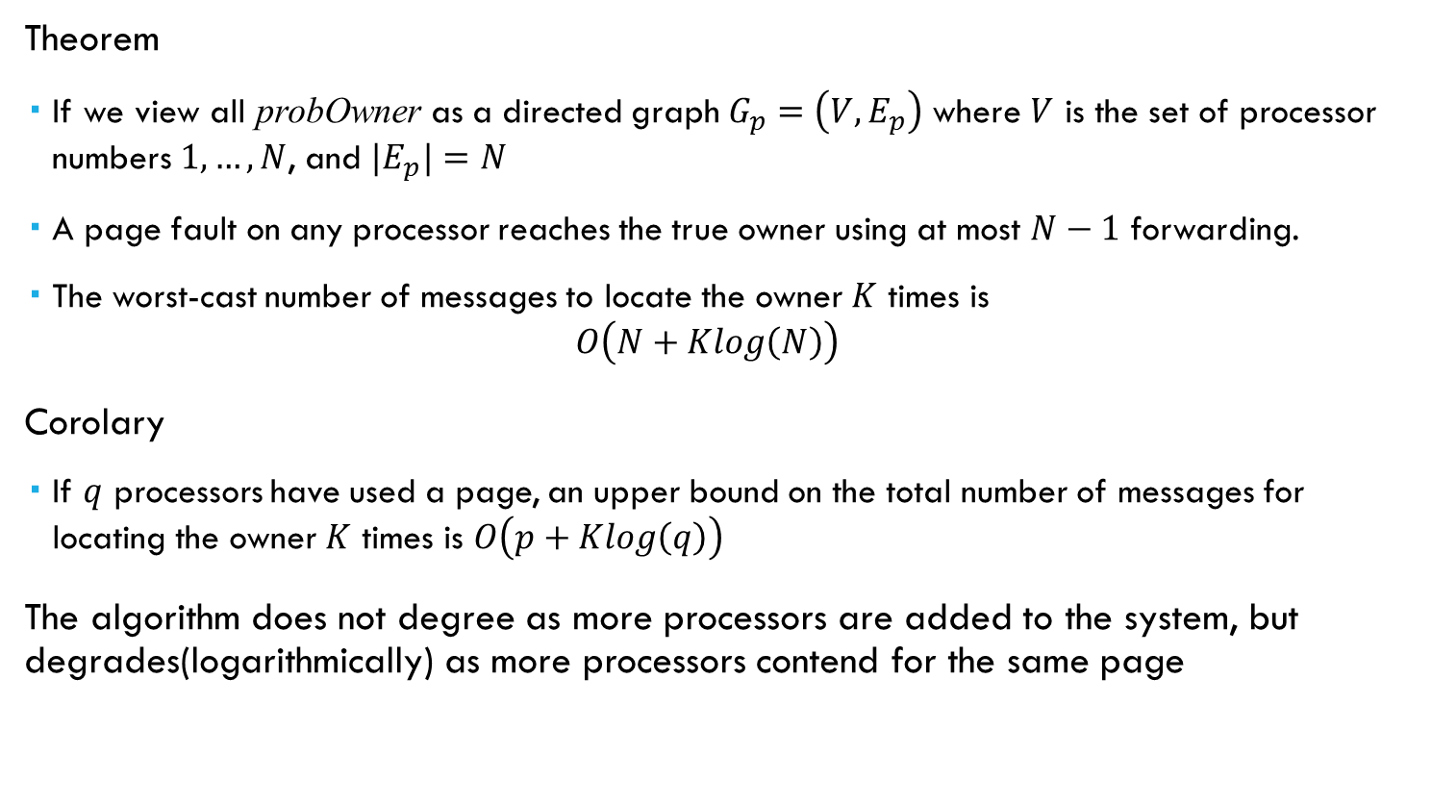
A Dynamic Distributed Manager Algorithm
Theorem
  If we view all probOwner as a directed graph $G_{p}=\left(V, E_{p}\right)$ where $V$ is the set of processor numbers $1, …, N$, and $|E_{p}|=N$
  A page fault on any processor reaches the true owner using at most $N−1$ forwarding.
  The worst-cast number of messages to locate the owner $K$ times is
  $O\left(N+Klog\left(N\right)\right)$
Corolary
  If $q$ processors have used a page, an upper bound on the total number of messages for locating the owner $K$ times is $O\left(p+Klog\left(q\right)\right)$
The algorithm does not degree as more processors are added to the system, but degrades(logarithmically) as more processors contend for the same page
Notes:
If we view all probOwners as a directed graph Gp=(V, Ep), where V is the set of processor, numbering from 1 to N, and the size of Ep is N
It can be proved that a page fault on any processor can reach the true owner after at most N-1 forwarding
And the worst cast number of messages to locate the owner K times is by O(N + K logN )
Then we can show that if q processors have used a page, the upper bound on the total number of messages to locate the owner, by K times, is O(p + K log q)
This is very important, because it reveals that this algorithm does not degree as more processors are added to the System, but only as more processors contend for the same page, and it increases logarithmically.

Slide 31
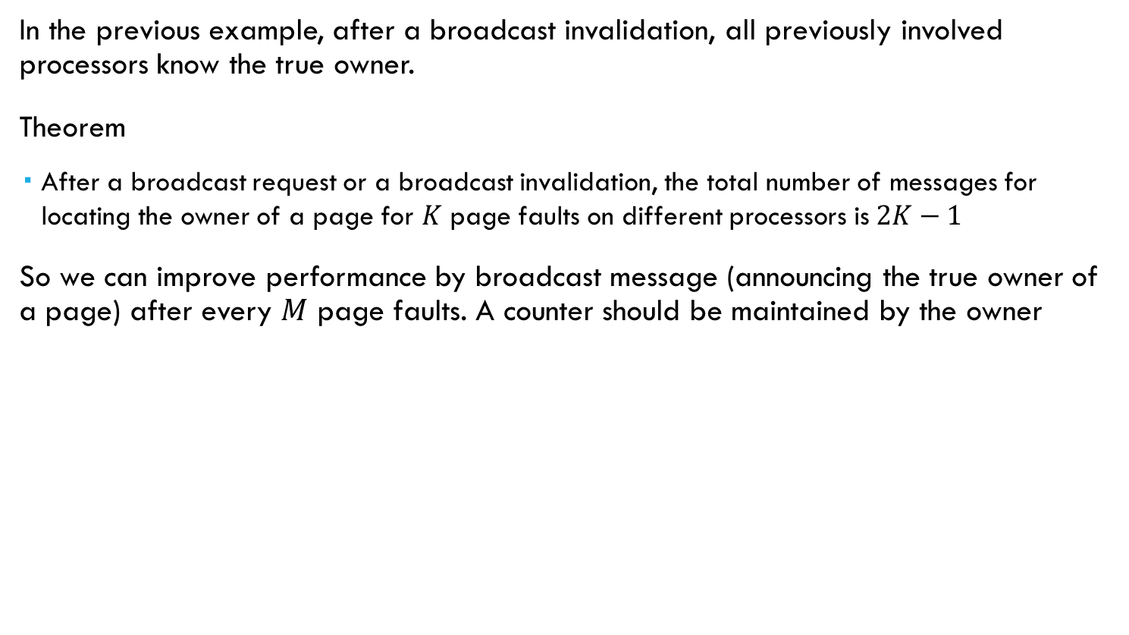
An Improvement by Using Fewer Broadcasts
In the previous example, after a broadcast invalidation, all previously involved processors know the true owner.
Theorem
  After a broadcast request or a broadcast invalidation, the total number of messages for locating the owner of a page for $K$ page faults on different processors is $2K−1$
So we can improve performance by broadcast message (announcing the true owner of a page) after every $M$ page faults. A counter should be maintained by the owner
Notes:
An improvement that can be made to this algorithm is to use fewer broadcasts.
In the previous example, after a broadcast invalidation, all previously involved processors know the true owner.
Thus, we can show that after a broadcast request or a broadcast invalidation, the total number of messages for locating the owner of a page for K times, on different processors, is 2K-1
So we can improve the performance by broadcasting the true owner of a page after certain number of page faults, to improve the performance. In this case, a counter should be maintained by the owner.

Slide 32
Distribution of Copy Sets
In previous algorithms
  copy set is only used for sending invalidation message, maintained by the owner.
  A copy operation has to find the true owner to be recorded in copy set.
Thus, we can give each processor a distributed copy set.
  Speeds up read operations; requester only needs to find a processor containing a copy of the requested page
  Speeds up invalidation message propagation
Notes:
Another improvement we can make is to distribute the copy set.
In the current design, the copy set is only used for sending invalidation messages and only maintained by the owner.
It means that even when it’s a read request, it has to find the true owner, so that it can be recorded in the copy set.
We can distribute the recording of copy set to all processors, to speed up the operation.
In this case, the requester only needs to find a processor who has a valid copy of the page.
Furthermore, when sending invalidation messages, it can be propagated by more processors, lowering the pressure on the owner

Slide 33
Distribution of Copy Sets: read fault
1. Send read fault request
2. Page copy sent to requester
Page
Read fault happens
Points to a processor’s probOwner
Processor with write access to page
Processor with read-only access to page
Processor with no valid local copy to page
Notes:
So after applying this improvement, when a processor has a read fault, it first send read fault request to its probOwner.
When the request has reached a processor with a valid copy, the page is copied again and sent to the requester.

Slide 34
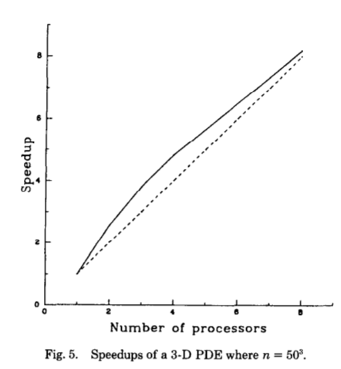
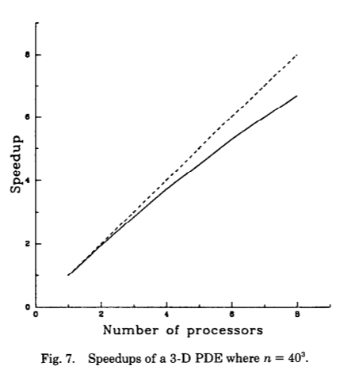
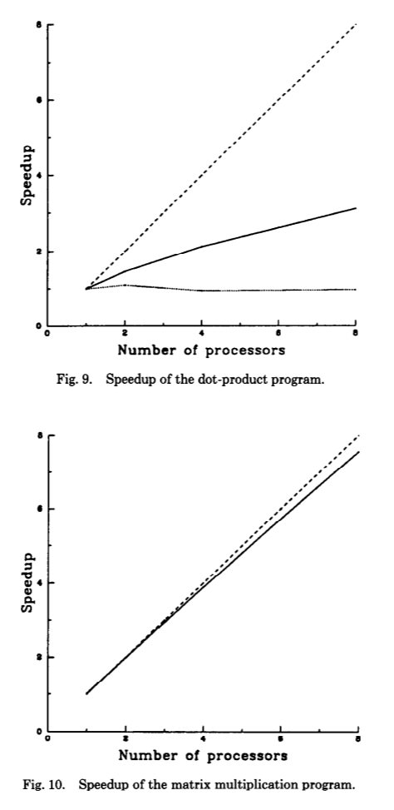
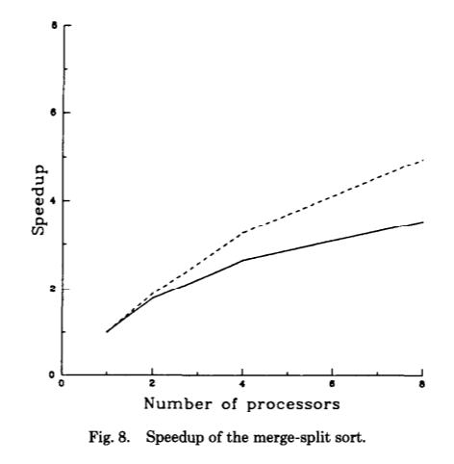
Experiment
4 benchmark program:
  3D Jacobi program for solving PDE
  Parallel merge-split sort
  Parallel matrix multiplication
  Parallel dot-product
SVM system performance
  Exploits the physical memories of a multiprocessor system, can even gain super-linear speedup
  Communication cost -> Requires high degree of locality
Notes:
Since a parallel program’s behavior is less predictable, it’s always useful to benchmark the algorithm. 4 bechmarks were designed to test the performance of the virtual memory system and compare the behavior of different implementations. The authors implemented the improved centralized algorithm, the fixed distributed algorihm and the dynamic distributed algorithm. Since at the time the paper was written the machine available were not very strong, the authors could only test the program on an 8-processor system and thus the difference overhead didn’t make the algorithms exhibit significant difference in performance. So here in the figures you only see one solid line.
And the results showed that in general the Shared Virtual Memory system can indeed exploit the physical memories of a multiprocessor. The execution time is usually saved linearly, which means the solid line is close to the dotted line, with the increase of processor number, for programs with high locality like matrix multiplication and PDE solving. When the data to deal with is large than the physical memory of single processor, the SVM system can even gain super-linear speedups, that is with n processors the execution time is even less than one n-th of that on a single processor system, since it reduces paging.
However, for tasks where communication cost exceeds the computation cost like sorting and dot product, the speed up is not so good.

Slide 35
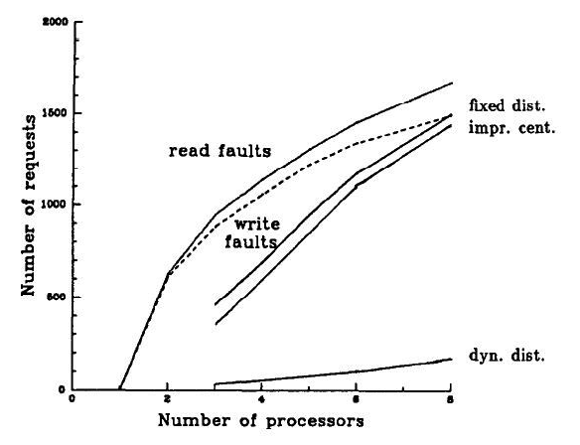
Experiment Result
Memory coherence algorithm comparison
  Having similar number of page faults
  Fixed distributed & centralized algorithm: have to make forwarding request a lot
  Dynamic distributed system’s probOwner field usually gives correct hits, thus the forward requests are not very much.
Notes:
For comparison between the memory coherence algorithms, the authors chose to measure the efficiency by counting the forward requests. For all algorithms there are approximately the same amount of page faults. But the fixed distributed and centralized algorithm have to make forwarding requests on non manager processors for almost every page fault, and thus expected to have performance inhibition when processor number increases. The overhead of the dynamic distributed manager algorithm is much less than that of the other 2. This confirms the analysis to it. The main reason it is better is that the probOwner field usually gives correct hints, reducing the number of forwarding requests.

Slide 36
Conclusion
Memory coherence problem solutions | Centralized manager | Straightforward and easy to implement Need ~ 4 messages to locate owner Traffic bottleneck
 | Distributed manager | Fixed | Need about 2 messages to locate owner Alleviate the bottleneck
 |  | Dynamic | May need as little as 1 message to locate owner Refinement available
In general, dynamic distributed manager algorithms perform better than other methods when the number of processors sharing the same page for a short period of time is small, which is the normal case. The good performance of the dynamic distributed manager algorithms shows that it is possible to apply it to an implementation on a large-scale multiprocessor.
Notes:
To sum up, this paper has studied two general classes of algorithms (centralized manager and distributed manager) for solving the memory coherence problem. The centralized manager algorithm is straightforward and easy to implement, but it may have a traffic bottleneck at the central manager when there are many page faults. The fixed distributed manager algorithm alleviates the bottleneck, but, on average, a processor still needs to spend about two messages to locate an owner. The dynamic distributed manager algorithm and its variations seem to have the most desirable overall features. It may need as little as one message to locate an owner. Further refinement can also be done, like by using fewer broadcasts or by distributing copy sets. In general, dynamic distributed manager algorithms perform better than other methods when the number of processors sharing the same page for a short period of time is small, which is the normal case. The good performance of the dynamic distributed manager algorithms shows that it is possible to apply it to an implementation on a large-scale multiprocessor.

Slide 37
Thank YOU!

